Slide 1
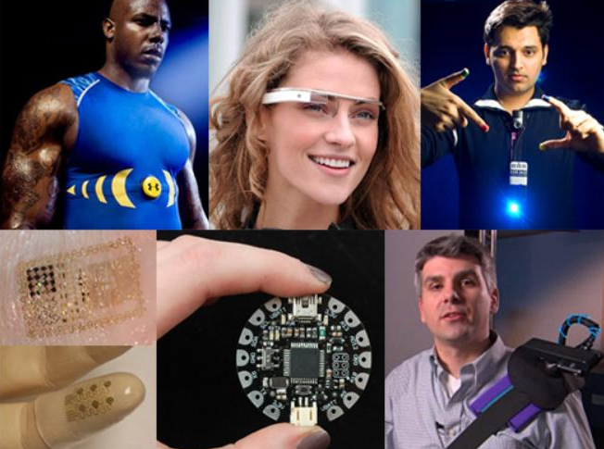
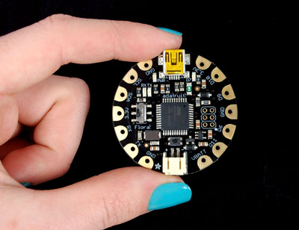
Wearable Electronics 3 Hour Summer Camp – Grade 6-8 Day 1

Slide 2
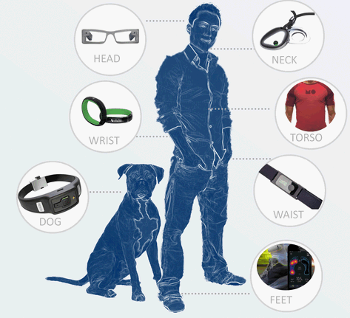
What are Wearable Electronics?
Our bodies are our primary interface for the world!
Interactive systems that live on the body can be upfront, intimate, literally on your face.
They can sit close to your skin, in your clothing and sometimes might feel like part of you!

Slide 3
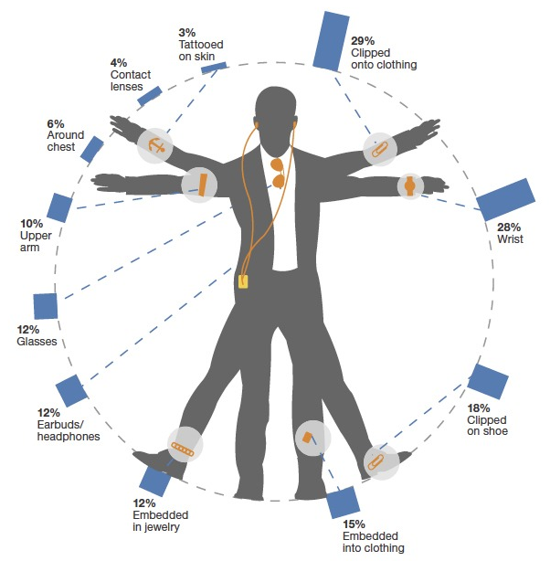
What do people think about Wearable Electronics?
In a survey of 5000 adults in the US (a year back) people were interested
in various wearables as shown here.

Slide 4
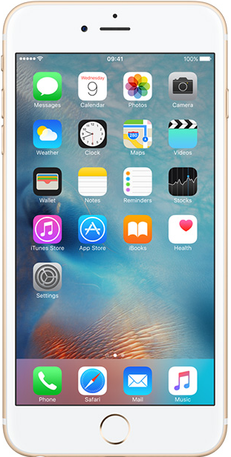
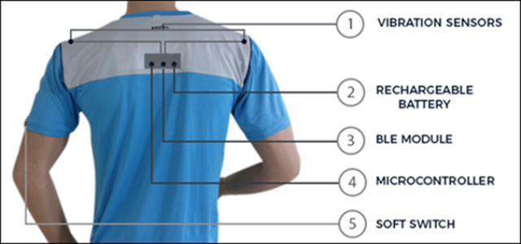
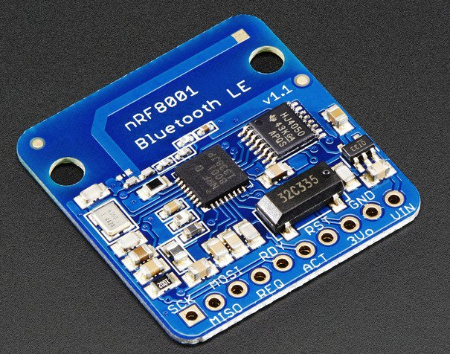
Anatomy of a sample Wearable device
Update App on phone
Bluetooth Low Energy
MOST IMPORTANT PART of a Wearable

Slide 5
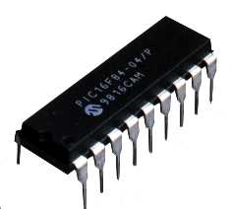
What are Microcontrollers?
A microcontroller is a self-contained system with peripherals, memory and a processor that can be used as an embedded system.
The simplest computer processor used as the “brain” of a system.
Depending on the taste of the manufacturer, a bit of memory, a few A/D converters, timers, input/output lines etc. are added
All that is placed in some of the standard packages.
A simple software able to control it all and which everyone can easily learn about has been developed.

Slide 6

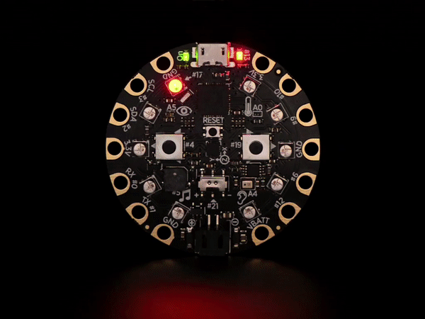
What are Microcontrollers?
Arduino is an open source computer hardware and software company, project, and user community that designs and manufactures single-board microcontrollers and microcontroller kits for building digital devices and interactive objects that can sense and control objects in the physical world.
Circuit Playground from Adafruit features an ATmega32u4 micro-processor. It also is round and has alligator-clip pads around it. You can power it from USB, a AAA battery pack, or Lipoly (for advanced users). Program your code into it, then take it on the go.

Slide 7
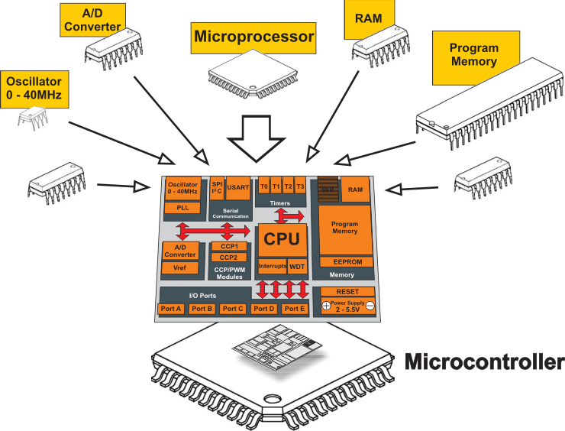
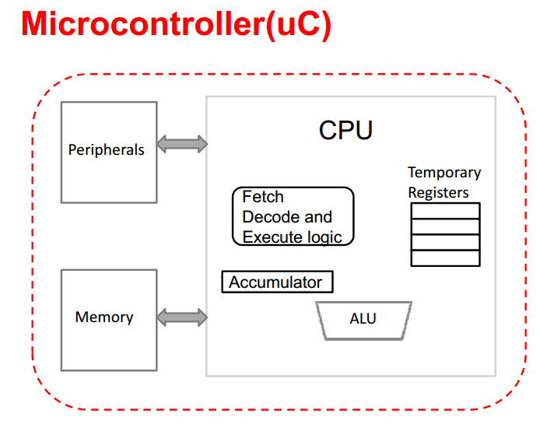
What is inside a Microcontroller?
A microcontroller chip or board typically has:
Central processing unit(CPU)
Random Access Memory)(RAM)
Read Only Memory(ROM)
Input/output ports
Timers and Counters
Interrupt Controls
Analog to digital converters
Digital analog converters
Serial interfacing ports
Oscillatory circuits

Slide 8
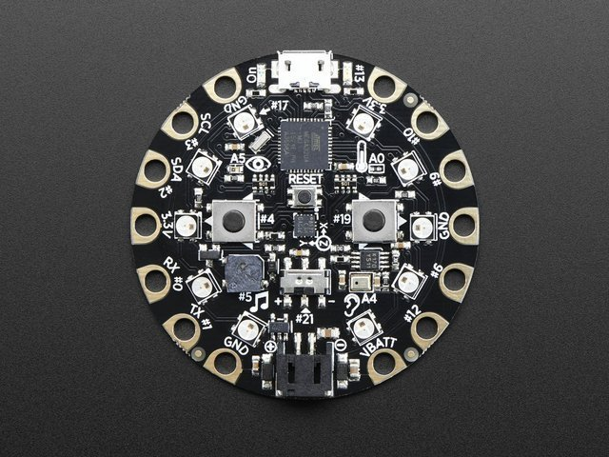
Introducing Circuit Playground
Circuit Playground is the name of the little round electronic circuit board that you are going to use as a tool to investigate and explore programming & electronics. Think of it as like a Swiss Army Knife or multi-tool for learning electronics as an art form! It is an all-in-one board so you can jump in quickly and do a whole lotta projects (It can slice, it can dice, it has lots of blinky LEDs!)

Slide 9
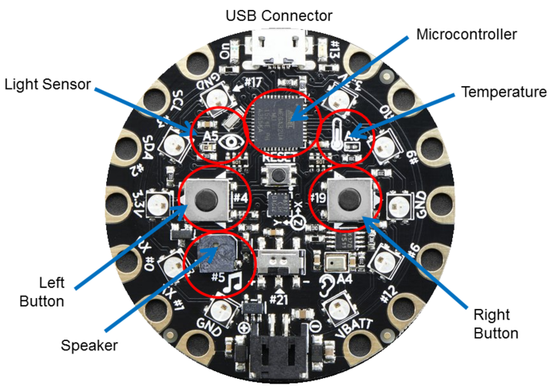
Introducing Circuit Playground

Slide 10
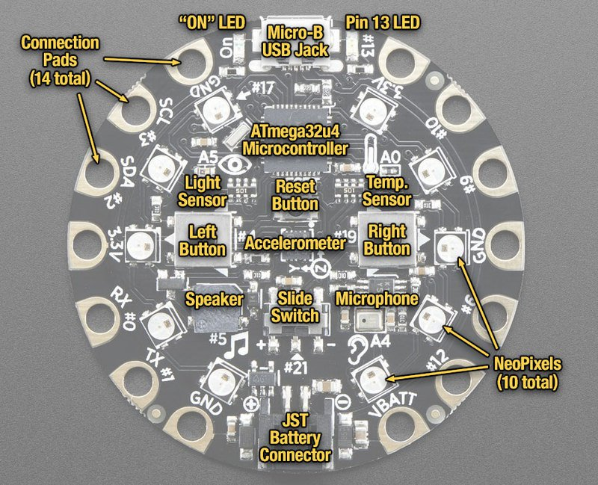
Introducing Circuit Playground

Slide 11
Introducing Circuit Playground
10 x mini NeoPixels, each one can display any rainbow color
1 x Motion sensor (LIS3DH triple-axis accelerometer with tap detection, free-fall detection)
1 x Temperature sensor (thermistor)
1 x Light sensor (phototransistor)
1 x Sound sensor (MEMS microphone)
1 x Mini speaker (magnetic buzzer)
2 x Push buttons, left and right
1 x Slide switch
8 x alligator-clip friendly input/output pins Includes I2C, UART, and 4 pins that can do analog inputs/PWM output
All 8 pads can act as capacitive touch inputs
Green "ON" LED so you know its powered
Red "#13" LED for basic blinking
Reset button

Slide 12
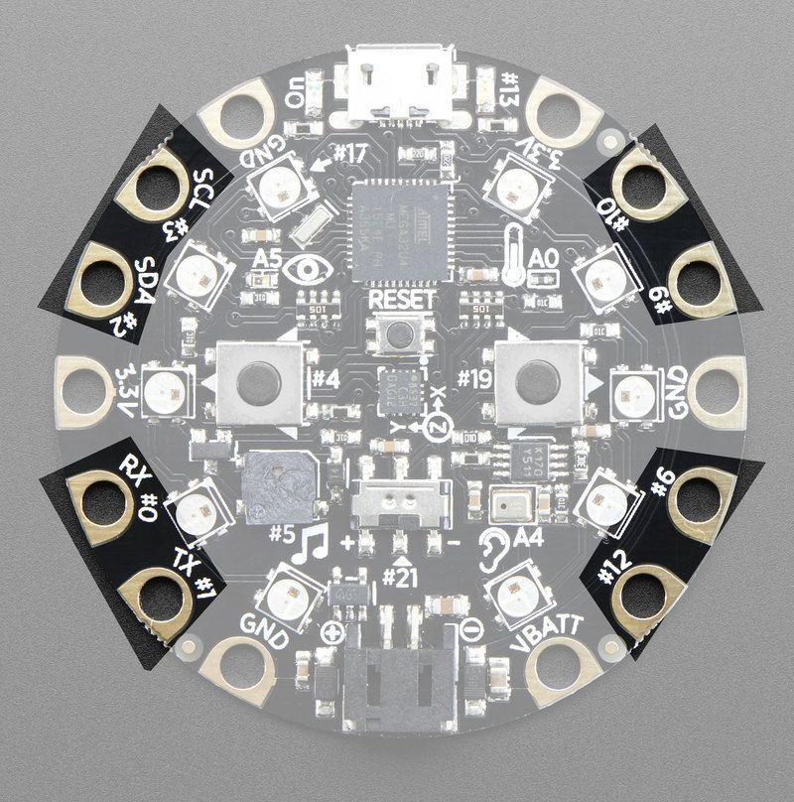
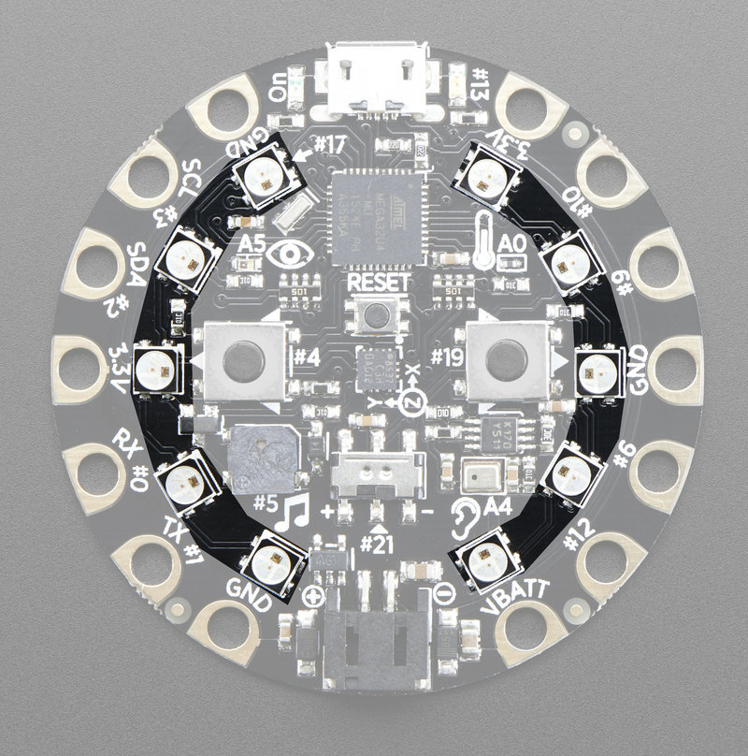
Introducing Circuit Playground
GPIO + Capacitive Touch Pads
Neo-Pixels

Slide 13
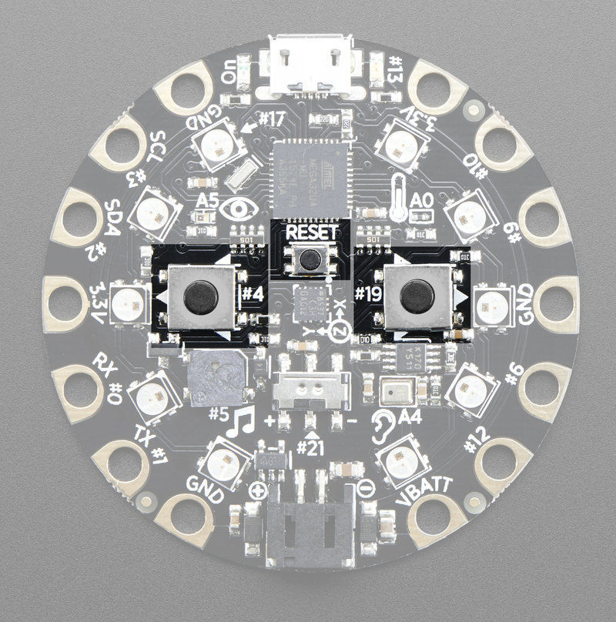
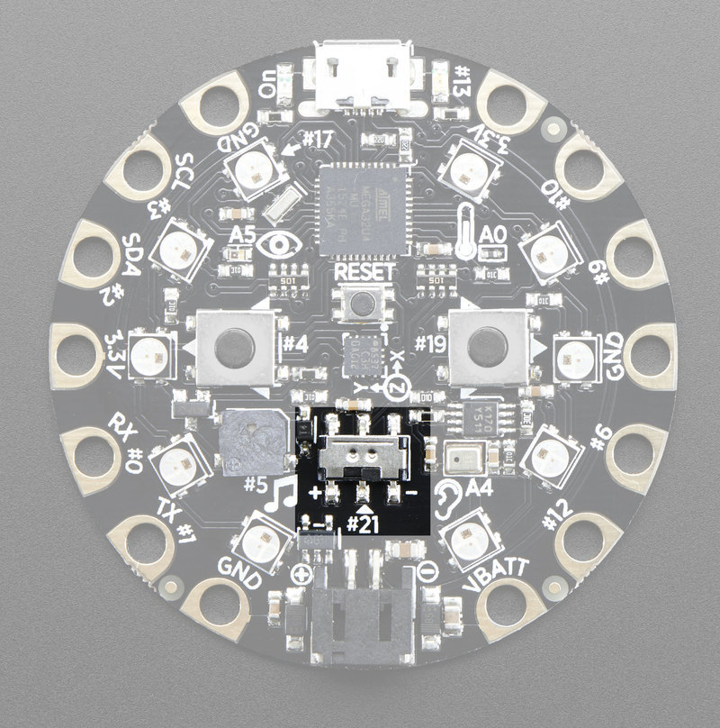
Introducing Circuit Playground
SWITCHES
Push Buttons
Slide switch

Slide 14
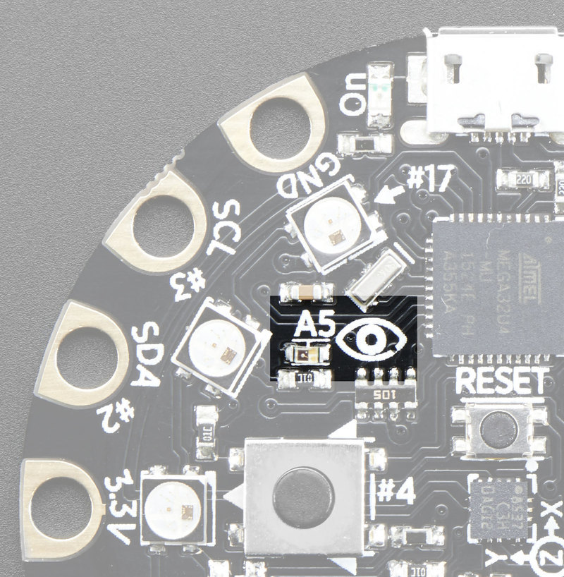
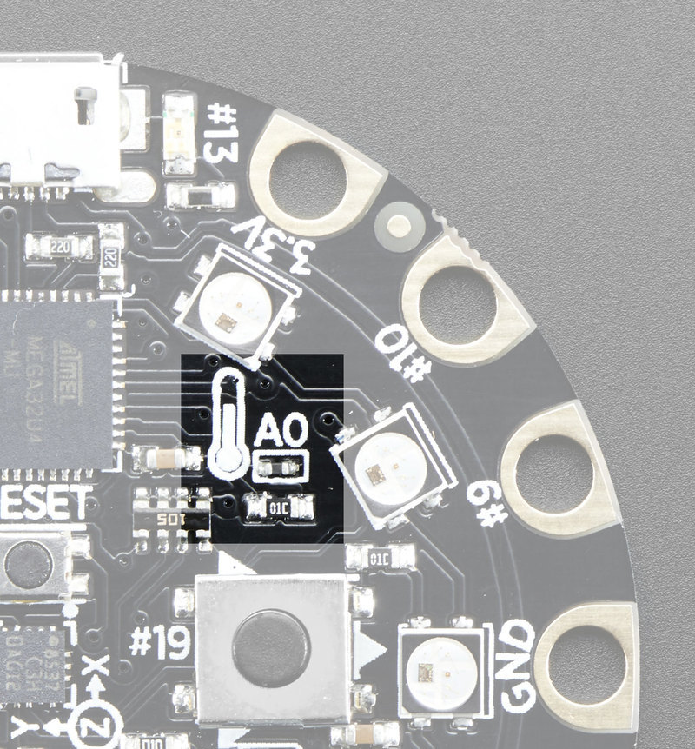
Introducing Circuit Playground
SENSORS
Light Sensor
Temperature Sensor
This sensor is connect to analog pin #A5 and will read between 0 and 1023 with higher values corresponding to higher light levels. A reading of about 300 is common for most indoor light levels.
Calculate the temperature based on the analog voltage on analog pin #A0

Slide 15
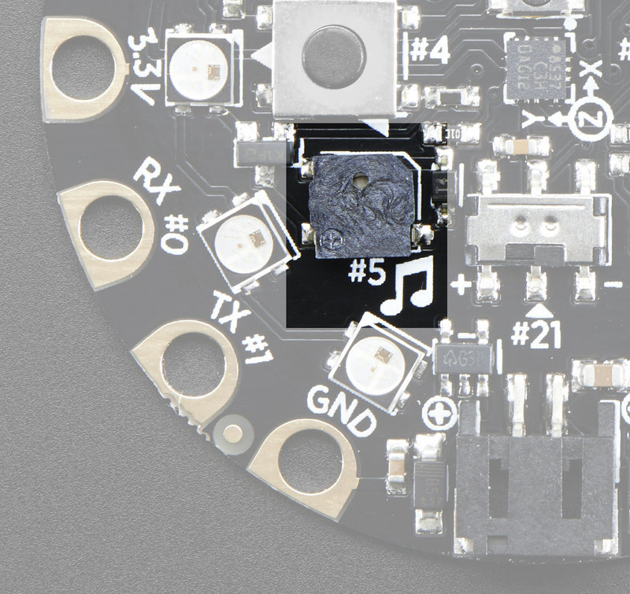
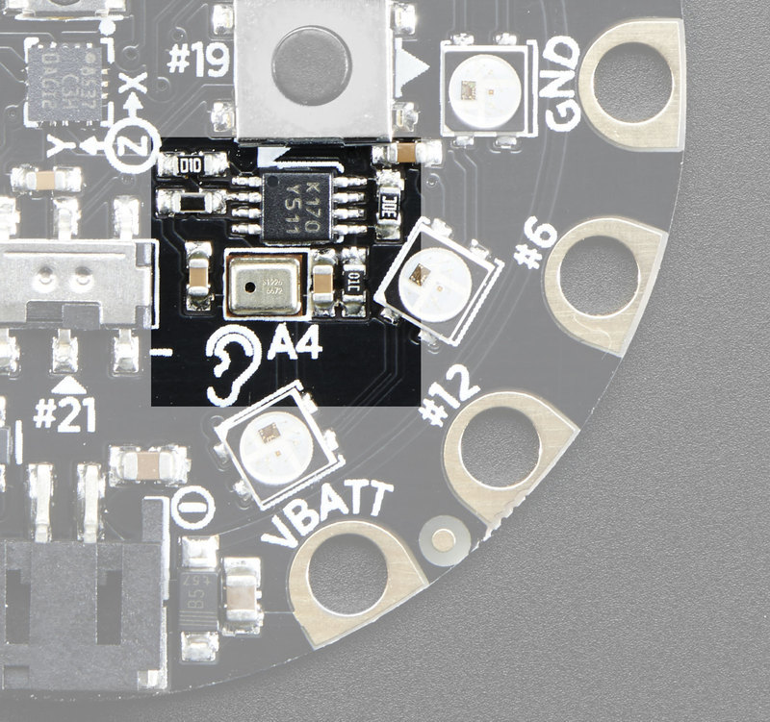
Introducing Circuit Playground
AUDIO
Speaker
Microphone
Make your circuit playground sing with the built in buzzer. This is a miniature magnetic speaker connected to digital pin #5 with a transistor driver. You can use PWM at varying frequencies to make basic tones.
You can read the analog voltage corresponding to the audio on analog pin #A4 (Raw analog audio waveform! When it's silent there will be a reading of ~330 and when loud the audio will read between 0 and 800 or so.

Slide 16
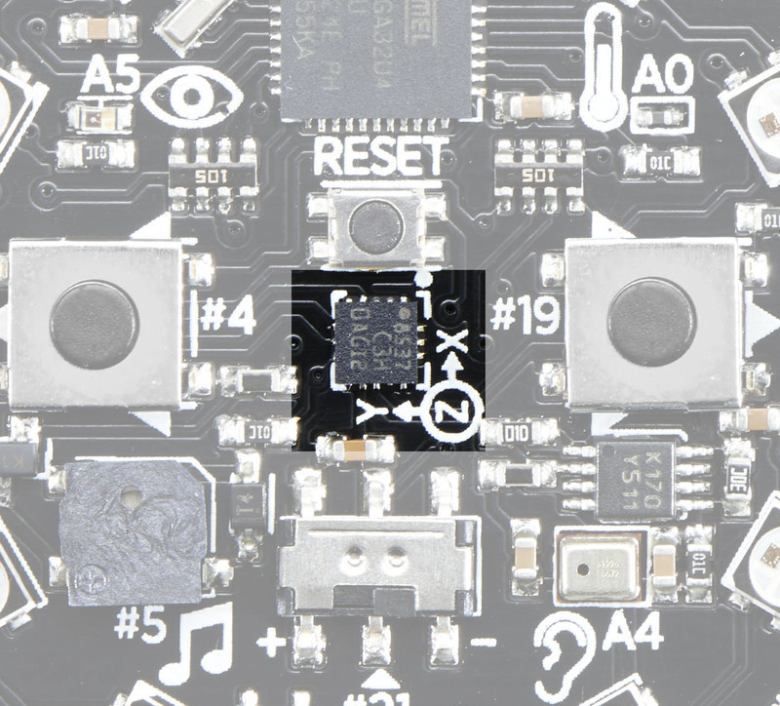
Introducing Circuit Playground
ACCELEROMETER
The 3-axis XYZ accelerometer is in the dead center of the board and you can use it to detect tilt, gravity, motion, as well as 'tap' and 'double tap' strikes on the board. The LIS3DH is connected to the hardware SPI pins (to leave the I2C pins free) and has the CS pin on digital pin #8 and an optional interrupt output on digital pin #7

Slide 17
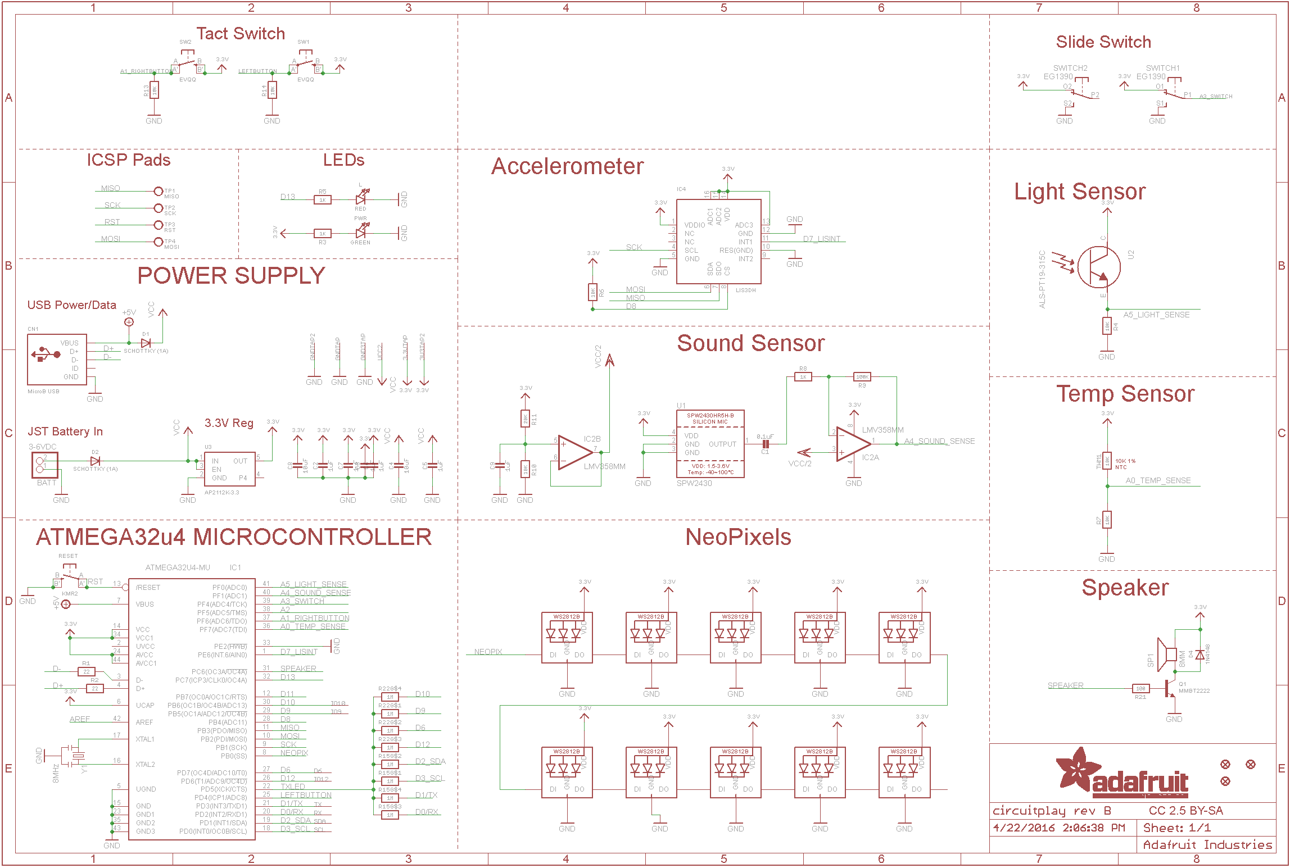
Introducing Circuit Playground

Slide 18
10 minutes break

Slide 19
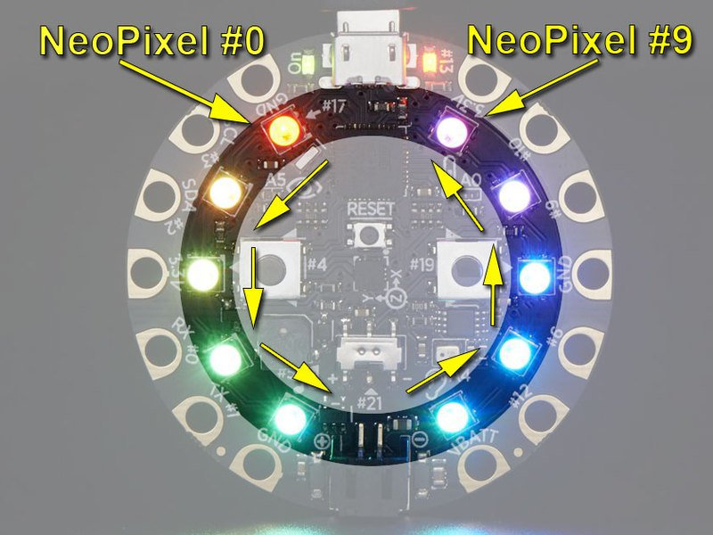
Project Time – Blinky Circuit!
These pixels are controlled by a single data pin, #17. Unlike non-smart RGB LEDs, you can set the color and a little chip inside the LED will handle the PWM for you.
Since they are controlled in a chain, you will need to tell the Circuit Playground's NeoPixel code which one you want to set the color for. Each NeoPixel is numbered, starting with #0 at the top left and going counter clockwise till you reach #9

Slide 20
Project Time – Blinky Circuit!
SET COLOR
CircuitPlayground.setPixelColor (n, red, green, blue)
Where n is between 0 and 9 and indicates which LED you are setting. red/green/blue vary between 0 (off) and 255 (full on)
CLEAR COLORS
You can quickly turn all the LEDs off with CircuitPlayground.clearPixels()
SET BRIGHTNESS
CircuitPlayground.setBrightness(b) where b varies from 0 (no LEDs will ever light) to 255 (incredibly bright!)

Slide 21
Code
#include <Adafruit_CircuitPlayground.h> // Change these to set speed (lower is faster) #define FLASH_RATE 250 #define SPIN_RATE 100 // Change these to be whatever color you want // Use color picker to come up with hex values #define FLASH_COLOR 0xFF0000 #define SPIN_COLOR 0xFF0000 /////////////////////////////////////////////////////////////////////////////// bool buttonsPressed() { return CircuitPlayground.leftButton() | CircuitPlayground.rightButton(); } /////////////////////////////////////////////////////////////////////////////// void flasher() { while (!buttonsPressed()) { // Turn on all the pixels to FLASH_COLOR for (int pixel=0; pixel<10; pixel++) { CircuitPlayground.setPixelColor(pixel, FLASH_COLOR); } // Leave them on for a little bit delay(FLASH_RATE); // Turn off all the NeoPixels CircuitPlayground.clearPixels(); // Leave them off for a little bit delay(FLASH_RATE); } }

Slide 22
Code
/////////////////////////////////////////////////////////////////////////////// void spinner() { // Can be any two pixels int pixel1 = 0; int pixel2 = 5; while (!buttonsPressed()) { // Turn off all the NeoPixels CircuitPlayground.clearPixels(); // Turn on two pixels to SPIN_COLOR CircuitPlayground.setPixelColor(pixel1, SPIN_COLOR); CircuitPlayground.setPixelColor(pixel2, SPIN_COLOR); // Increment pixels to move them around the board pixel1 = pixel1 + 1; pixel2 = pixel2 + 1; // Check pixel values if (pixel1 > 9) pixel1 = 0; if (pixel2 > 9) pixel2 = 0; // Wait a little bit so we don't spin too fast delay(SPIN_RATE); } } /////////////////////////////////////////////////////////////////////////////// void setup() { CircuitPlayground.begin(); // Make it bright! CircuitPlayground.setBrightness(255); } /////////////////////////////////////////////////////////////////////////////// void loop() { flasher(); delay(250); spinner(); delay(250); }

Slide 23
Q&A

Slide 24
What are Wearable Electronics?
What are Microcontrollers? Where are they used?
Introduction to Circuit Playground, pins, sensors, switches and more…
PROJECT TIME: Blinky/Flash/Spin NeoPixel Circuit
1. https://learn.adafruit.com/circuit-playground-lesson-number-0?view=all#library-reference

